Slide 1

AWS Lambdas. Serverless.
Maybe someone has seen my server?
Justas Eimutis – Software Engineer

Slide 2
What is it?

Slide 3
Don’t Get Lost
Serverless - an execution model where the cloud provider is responsible auto-scale and auto-provisioning. Pay only for what you use.
Lambda – Serverless computing platform (FaaS) provided by Amazon.
Serverless Framework – abstraction layer, that allows to deploy applications on any FaaS provider

Slide 4
Serverless
Auto-scale and auto-provisioning
Cloud provider is only charging for the amount of resources used to run the code.
No server management

Slide 5
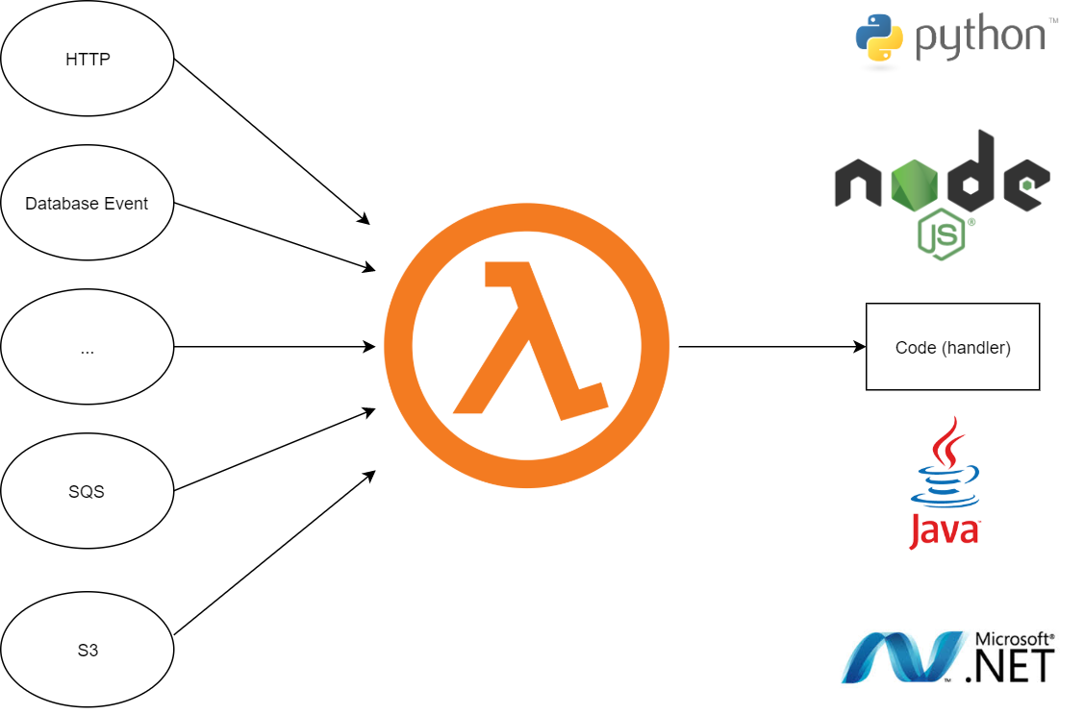

Slide 6
Serverless != No servers

Slide 7
AWS Lambda
AWS Lambda is an event-driven, serverless computing platform provided by Amazon
Easily integrates with AWS services (S3, SQS, DynamoDB)
It automatically manages the computing resources, auto-scales
You pay only for resources you use

Slide 8
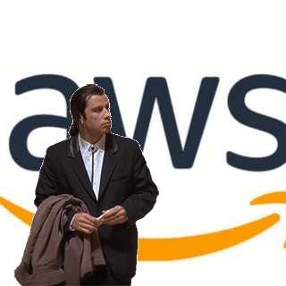

Slide 9

Hands-On Serverless
Let’s build a startup.
Real time sport scores
Advanced statistics
Sport news

Slide 10
Perfect Fit
Concentrate on features, not on server
Auto-scaling
Idle for 20 hours per day

Slide 11


Hey man, it’s serverless and stuff, but how should I debug it?

Slide 12
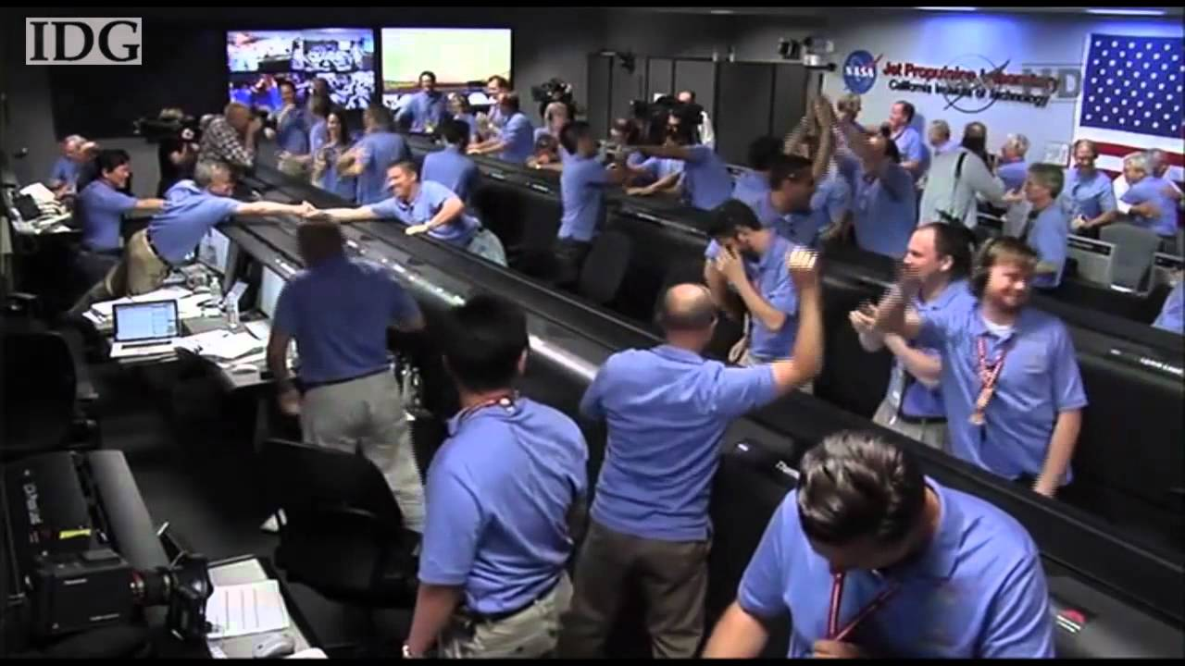
App Is Live In Record Time

Slide 13
“ Your scores lag 5 minutes behind real result!
- John LeBron.
Here We Go
“I managed to get a coffee while score box was opened.
- Sam Valanciunas.
“Hey, login took 10 seconds. Is that normal?
- Joe Startuper.

Slide 14
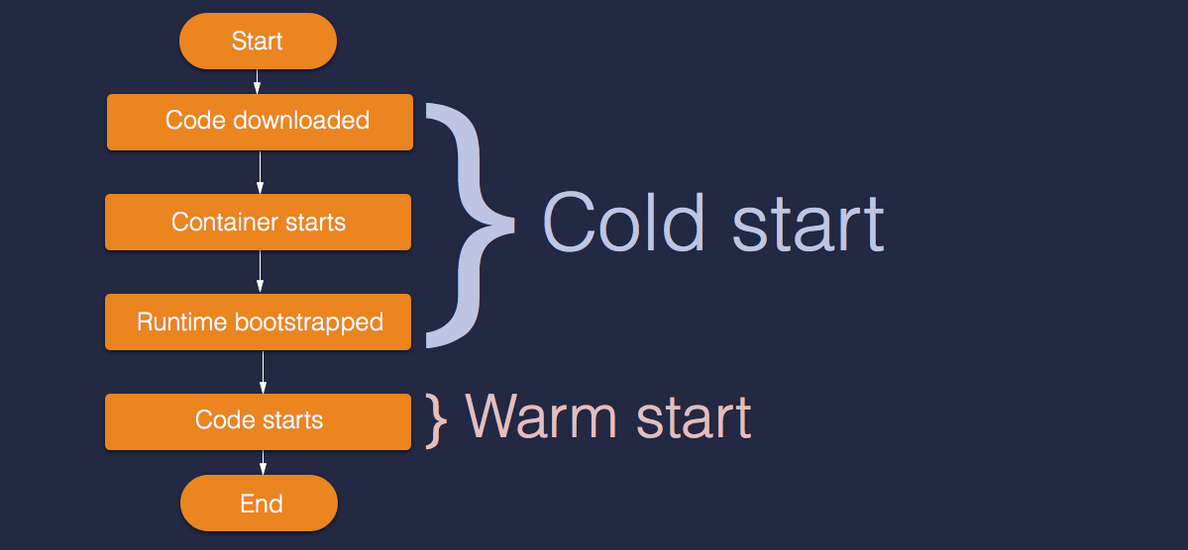
https://blog.travelex.io/from-containers-to-aws-lambda-23f712f9e925

Slide 15


Slide 16
Dealing With Cold Starts
Avoid VPC
Use latest SDK
Lightweight frameworks
Warm Up
More computing power

Slide 17
Processing Power
More memory = more CPU
At 1792 MB you get 1 full CPU

Slide 18
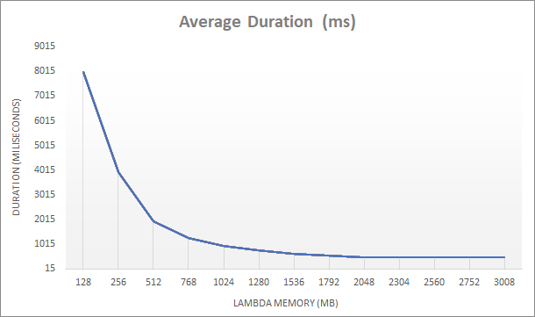
https://hackernoon.com/lower-your-aws-lambda-bill-by-increasing-memory-size-yep-e591ae499692

Slide 19
It’s Startup, isn’t it?
Let’s allow our users to upload photos from sport event.
Download stat reports

Slide 20
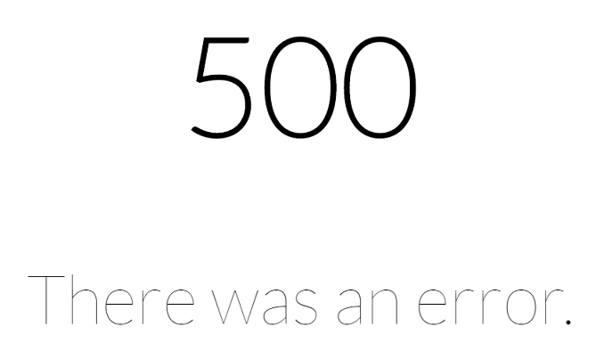
Whoops

Slide 21
Limitations
HTTP request – 30 seconds
Asynchronous processing – 15 minutes
Request size – 2 MB
Response size – 6 MB

Slide 22
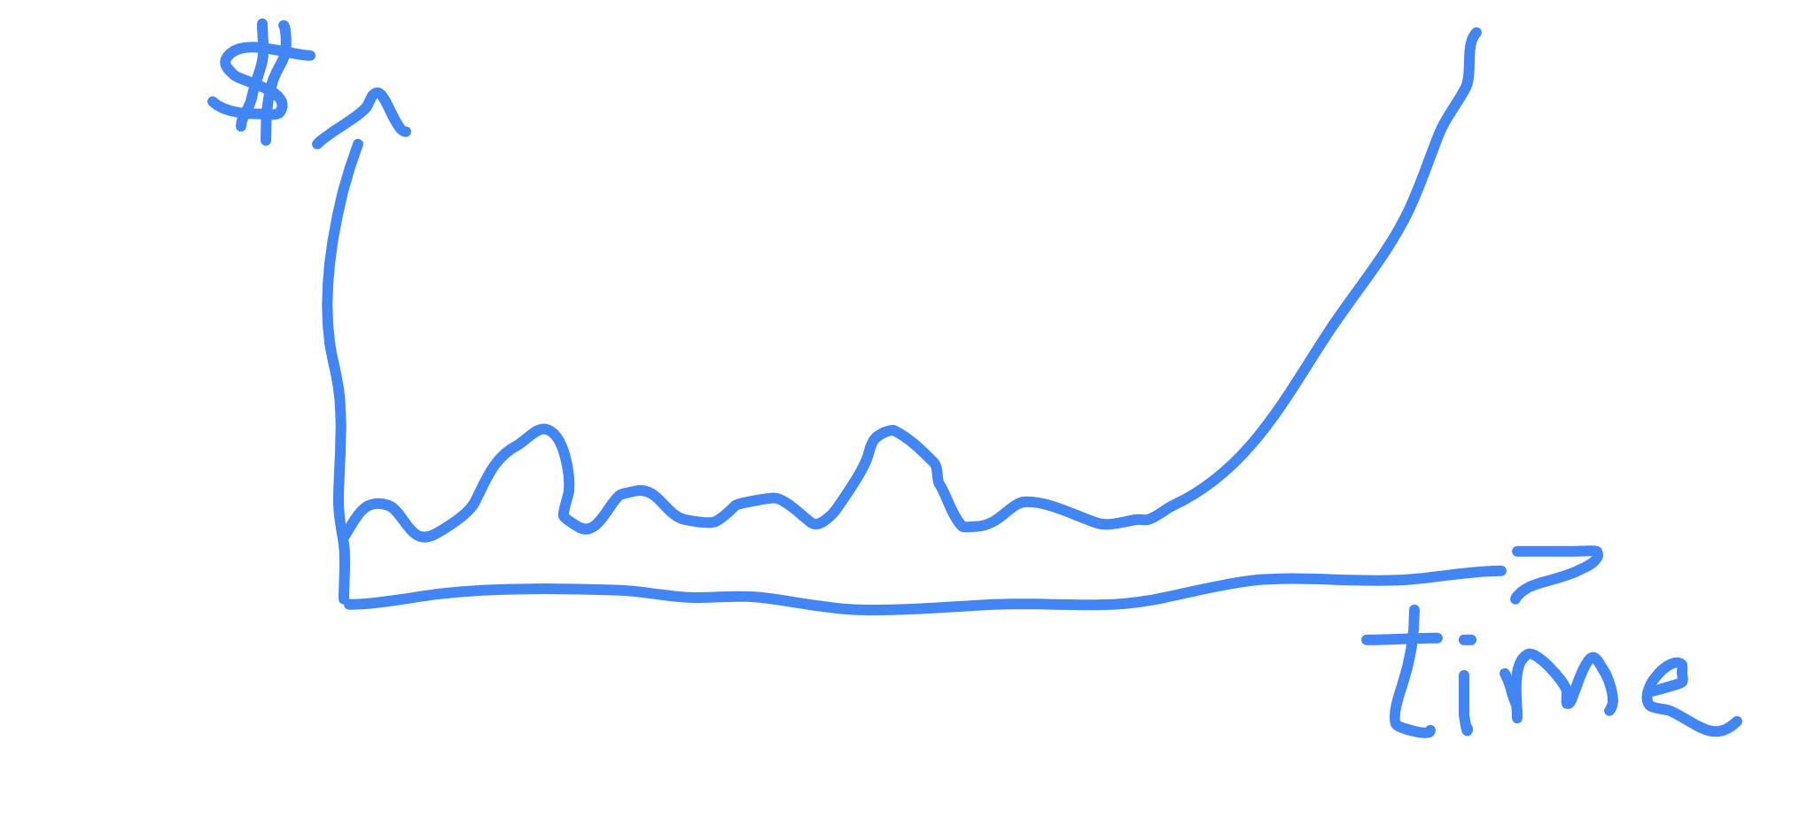
Account Suspended. Not enough money

Slide 23
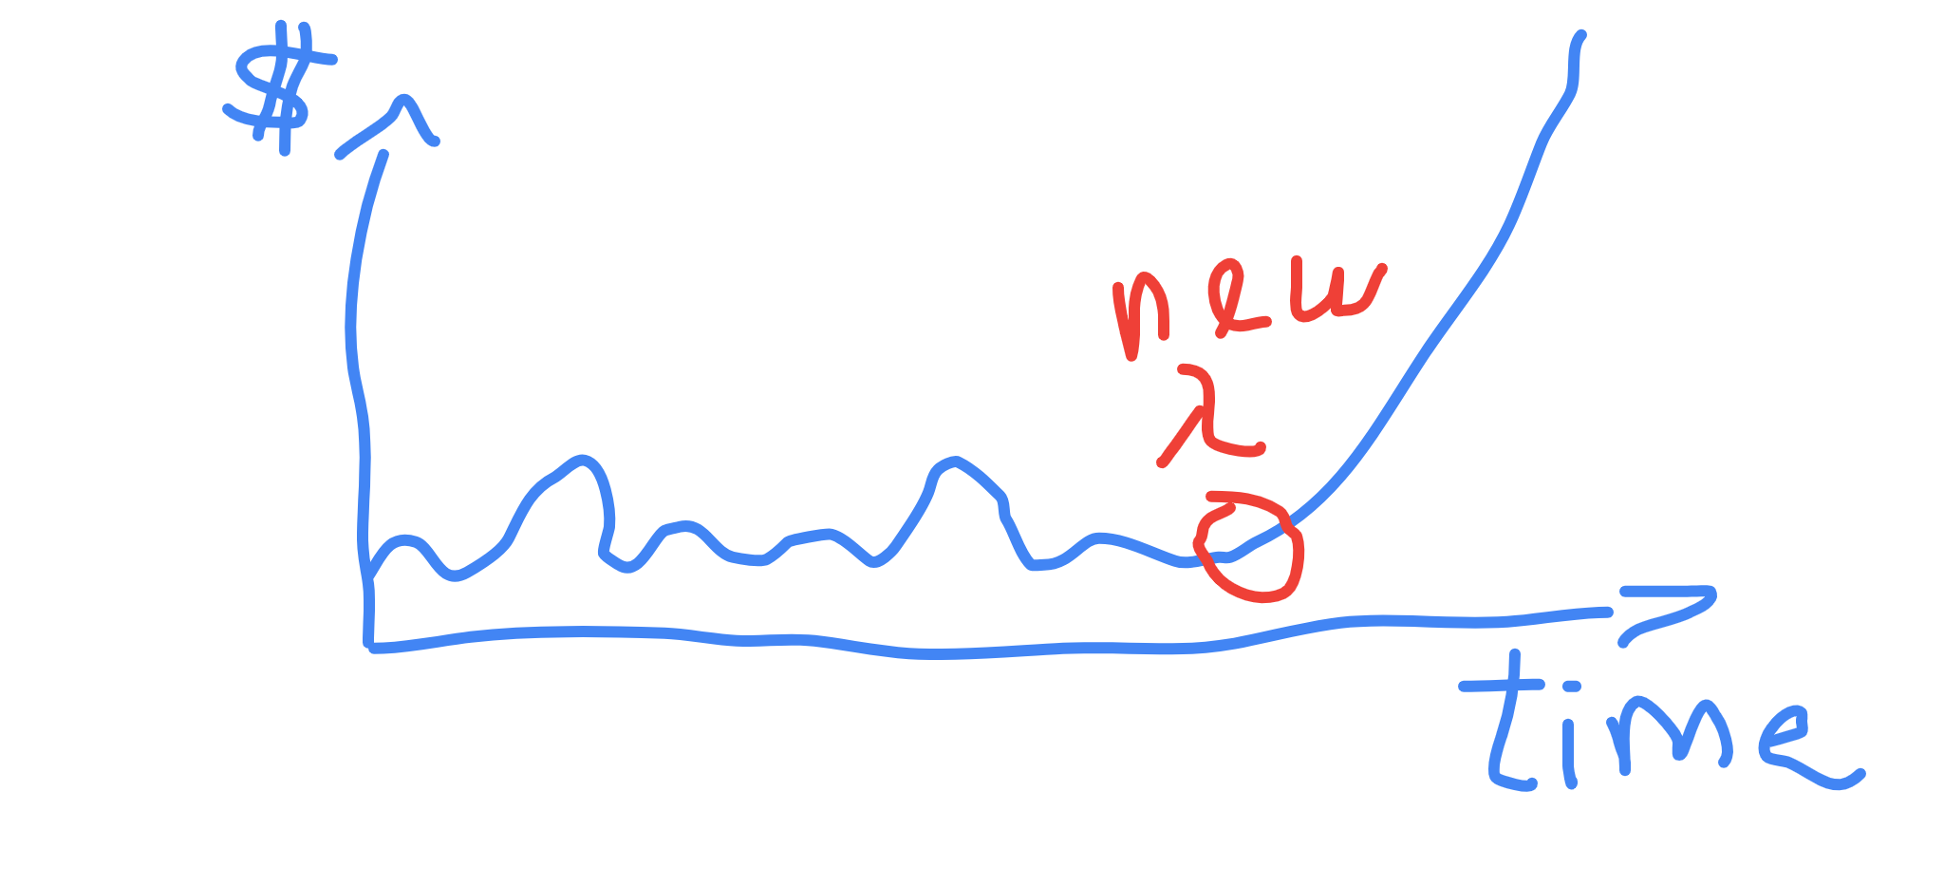
Account Suspended. Not enough money

Slide 24
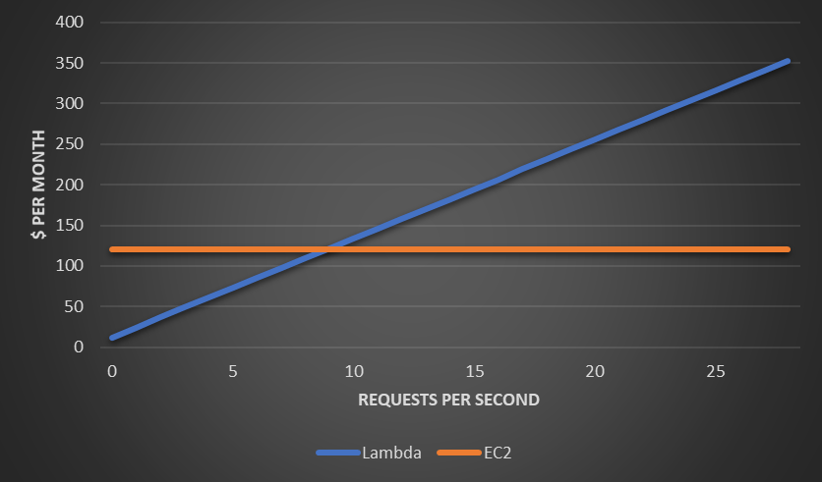
Lambda(1.5GB, ~450 ms) vs EC2 (16GiB RAM, 4vCPU)

Slide 25
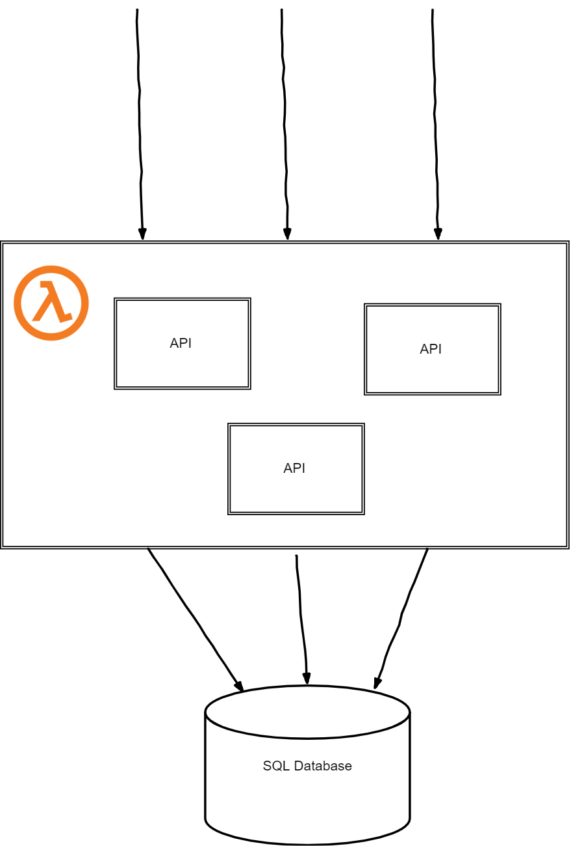
Working Architecture
Few requests – few API instances created

Slide 26
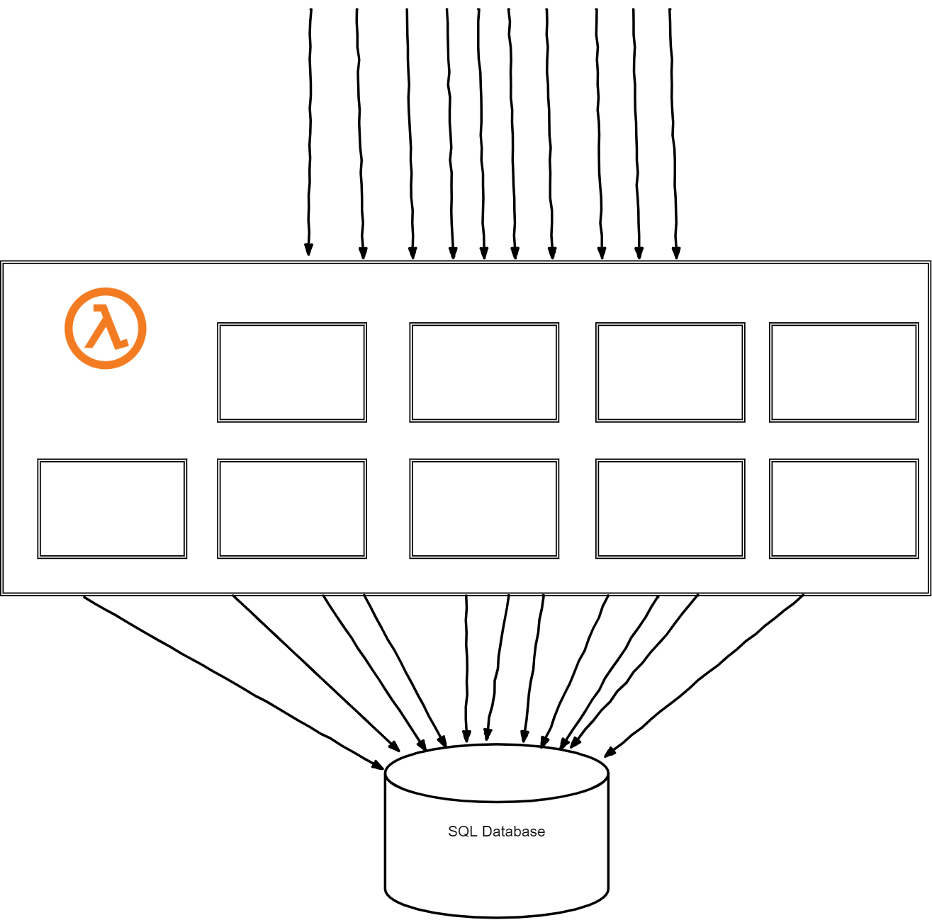
Game Time!
Application scaled on it’s on behalf, handling increased traffic

Slide 27
Scale Down
With decreased traffic lambda scales down to few API instances.

Slide 28
Finals Time!
Applications scales even more with increased traffic

Slide 29

Game Time!
Application scaled on it’s on behalf, handling increased traffic

Slide 30
Whoops. Again.

Slide 31
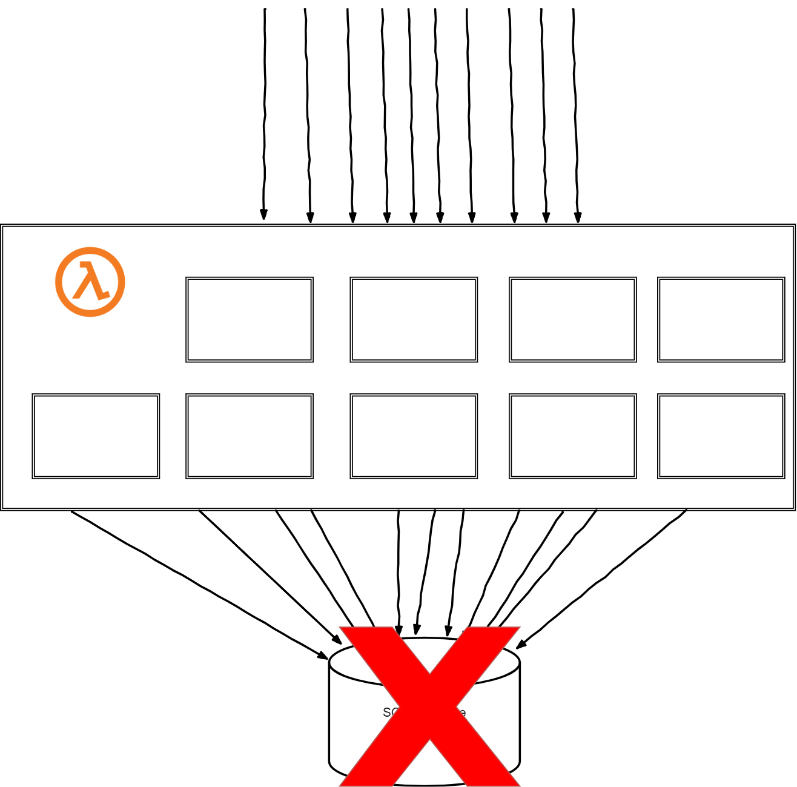
Scalable or Not?
As much as your application is scalable, it doesn’t mean that external services can scale at same ratio

Slide 32
Serverless databases
AWS offers serverless databes (Aurora)
Data API (SQL over HTTPS)
DynamoDB
CosmosDB

Slide 33
Lessons learned. What are the results?
Saved costs
Less time for Ops – more for creating business value
Speed to market
Develop with limitations and concurrency in mind
More gray hair

Slide 34
Use Cases
Asynchronous event processing application
Unpredictable traffic (auto – scaling)
Price is top priority

Slide 35
Simple VM Sometimes Is Enough
Long taking requests ( more than 30 seconds )
Constant high traffic
Performance critical systems

Slide 36
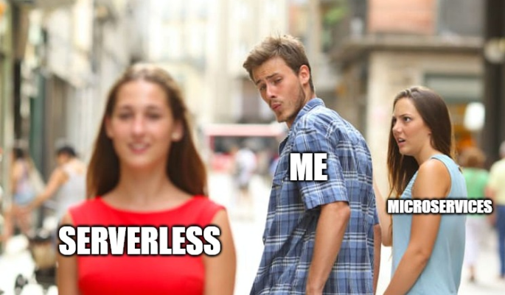
Don‘t Jump Into Hype Train

Slide 37
Code Examples

Slide 38
Simple Handler
public class DemoHandler implements RequestHandler<List<Integer>, Response> { private SomeHardWorkingService someHardWorkingService = new SomeHardWorkingService(); @Override public Response handleRequest(List<Integer> input, Context context) { System.out.println(“JUG Handler Start: " + input); Response response = someHardWorkingService.doingHardWork(input); System.out.println(“JUG Handler sends the response: " + response); return response; } }

Slide 39
Use latest SDK’s
while (position != null) { GetRestApisRequest apisRequest = new GetRestApisRequest(); apisRequest.setPosition(position.isEmpty() ? null : position); GetRestApisResult apisResult = client.getRestApis(apisRequest); position = apisResult.getPosition(); String result = apisResult.getItems() .stream() .filter(api -> api.getName().equals(“JUG")) .findFirst() .map(RestApi::getId) .orElse(""); }

Slide 40
Serverless framework
service: JUG frameworkVersion: '>=1.2.0 <2.0.0' provider: name: aws runtime: java8 memorySize: 256 region: us-west-2 package: artifact: build/distributions/jug-lambda.zip functions: demoFunction: handler: com.serverless.ApiHandler events: - http: path: jug method: get

Slide 41
Questions?
Feedback.

